Slide 1
논리회로 실습 01
Logic minimization
상명대학교 컴퓨터과학과
2018년 1학기

Slide 2
Lab 01-1
Design a combination logic by starting with a BDF as shown in the figure below.
결과로 다음의 세 가지 모두를 제출:
  BDF File capture
  RTL Viewer capture
  Simulation capture
  Test bench capture
a
b
f1
c
f2
d

Slide 3
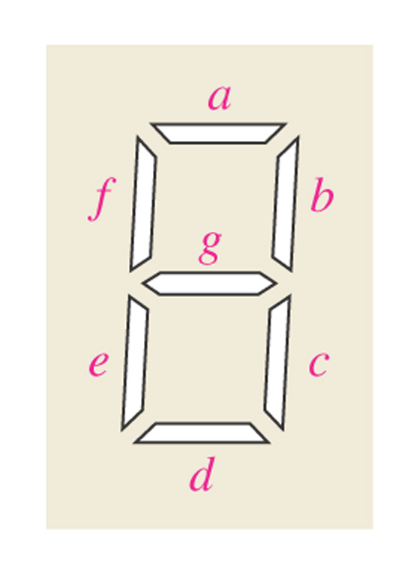
Lab 01-2
Design a combination logic for a, b, c, and d to drive 7-segment display.
  1st step: Make the truth table for 4 inputs
  2nd step: Minimize the logic gates using Karnaugh Map
  3rd step: Draw BDF file
  4th step: Simulation
결과로 다음의 네 가지 모두를 제출:
  BDF File capture
  RTL Viewer capture
  Simulation capture
  Test bench capture

